Slide 1


Checker Framework
By Ingmar van der Steen

Slide 2
What does this code do?
Optional<Integer> optional = Optional.empty(); optional.get();

Slide 3
What does this code do?
Optional<Integer> optional = Optional.empty(); optional.get();
Exception in thread "main" java.util.NoSuchElementException: No value present
at java.util.Optional.get(Optional.java:135)

Slide 4
What does this code do?
private static int compare(int x, int y) { return x < y ? x : null; }
compare(5,4);

Slide 5
What does this code do?
private static int compare(int x, int y) { return x < y ? x : null; }
compare(5,4);
Exception in thread "main" java.lang.NullPointerException

Slide 6
What does this code do?
private void processRequest() { String data = getUserInput(); executeSqlQuery(data); }

Slide 7
What does this code do?
private void processRequest() { String data = getUserInput(); executeSqlQuery(data); }
SQL injection?

Slide 8

Custom pluggable types for Java

Slide 9
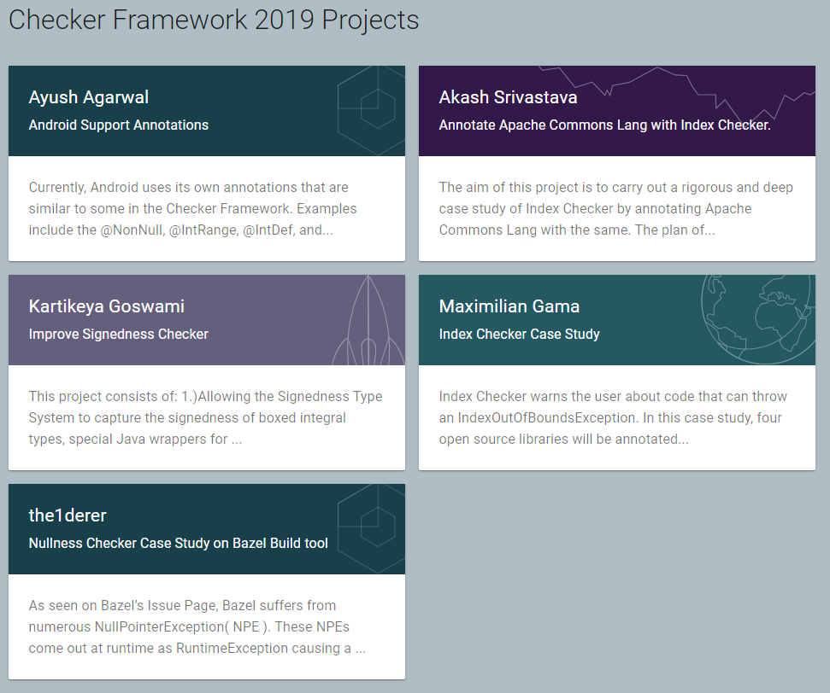
Custom pluggable types for Java

Slide 10
What does this code do the compiler say?
Optional<Integer> optional = Optional.empty(); optional.get();

Slide 11
What does this code do the compiler say?
Optional<Integer> optional = Optional.empty(); optional.get();
OptionalExamples.java:[11,39] [method.invocation.invalid] call to get() not allowed on the given receiver.
found : @MaybePresent Optional
[WARNING]
required: @Present Optional

Slide 12
What does this code do the compiler say?
private static int compare(int x, int y) { return x < y ? x : null; }
compare(5,4);

Slide 13
What does this code do the compiler say?
private static int compare(int x, int y) { return x < y ? x : null; }
compare(5,4);
NullExamples.java:[58,21] [unboxing.of.nullable] unboxing a possibly-null reference x < y ? x : null

Slide 14
What does this code do the compiler say?
private void processRequest() { String data = getUserInput(); executeSqlQuery(data); }

Slide 15
What does this code do the compiler say?
private void processRequest() { String data = getUserInput(); executeSqlQuery(data); }
TaintingExamples.java:[18,21] [argument.type.incompatible] incompatible types in argument.
found : @Tainted String
[WARNING]
required: @Untainted String

Slide 16
Let’s get started…
<dependencies> <dependency> <groupId>org.checkerframework</groupId> <artifactId>checker-qual</artifactId> <version>2.11.1</version> </dependency> <dependency> <groupId>org.checkerframework</groupId> <artifactId>jdk8</artifactId> <version>2.11.1</version> </dependency> <dependency> <groupId>org.checkerframework</groupId> <artifactId>checker</artifactId> <version>2.11.1</version> </dependency> </dependencies>

Slide 17
Let’s get started…
<plugin> <artifactId>maven-compiler-plugin</artifactId> <version>3.8.1</version> <configuration> <annotationProcessorPaths> <path> <groupId>org.checkerframework</groupId> <artifactId>checker</artifactId> <version>2.11.1</version> </path> <path> <groupId>com.infosupport</groupId> <artifactId>checkerframework</artifactId> <version>1.0-SNAPSHOT</version> </path> </annotationProcessorPaths> <annotationProcessors> <annotationProcessor>org.checkerframework.checker.nullness.NullnessChecker</annotationProcessor> <annotationProcessor>org.checkerframework.checker.optional.OptionalChecker</annotationProcessor> </annotationProcessors> </configuration> </plugin>

Slide 18


Slide 19
Subtyping checker

Slide 20
Subtyping checker
Animal
Cat

Slide 21
Subtyping checker
@Tainted
Animal
@Untainted
Cat

Slide 22
Subtyping checker
@PossiblyUnencrypted
@Tainted
Animal
@Untainted
Cat

Slide 23
Subtyping checker
@PossiblyUnencrypted
@Tainted
Animal
@Encrypted
@Untainted
Cat

Slide 24
Defining custom type qualifiers
@DefaultQualifierInHierarchy @SubtypeOf({}) @Target({ElementType.TYPE_USE, ElementType.TYPE_PARAMETER}) public @interface PossiblyUnencrypted {}

Slide 25
Defining custom type qualifiers
@DefaultQualifierInHierarchy @SubtypeOf({}) @Target({ElementType.TYPE_USE, ElementType.TYPE_PARAMETER}) public @interface PossiblyUnencrypted {}
@SubtypeOf(PossiblyUnencrypted.class) @Target({ElementType.TYPE_USE, ElementType.TYPE_PARAMETER}) public @interface Encrypted {}

Slide 27
Remember this one?
Optional<Integer> optional = Optional.empty(); optional.get();
OptionalExamples.java:[11,39] [method.invocation.invalid] call to get() not allowed on the given receiver.
found : @MaybePresent Optional
[WARNING]
required: @Present Optional

Slide 28
Remember this one?
“For an instance method, the receiver parameter represents the object for which the method is invoked. (…) the parameter exists so that the type may be annotated.” (Java Language Specification 8)

Slide 30
Limitations framework
‘Checker’ aims to be sound: no errors => code is correct
Theoretically impossible to eliminate all false positives
Try to refactor or use, e.g.: @SuppressWarnings

Slide 31
Final thoughts & takeaways
Start prevent your run time errors
PropertyChecker, RegexChecker, PurityChecker, IndexChecker…
Start using it on critical code
Fits in a domain-driven design
Subclassing could be a solution but can break code
What about FindBugs and SonarLint?

Slide 32
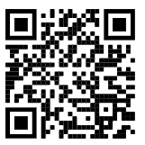
Thanks!

